Slide 1


Slide 2
Agenda:
1. What is Measurement?
2. Direct Measures.
3. Indirect Measures.
4. Subject (Soft) Measures.
5. What is Data?.
6. Data Presentation.

Slide 3
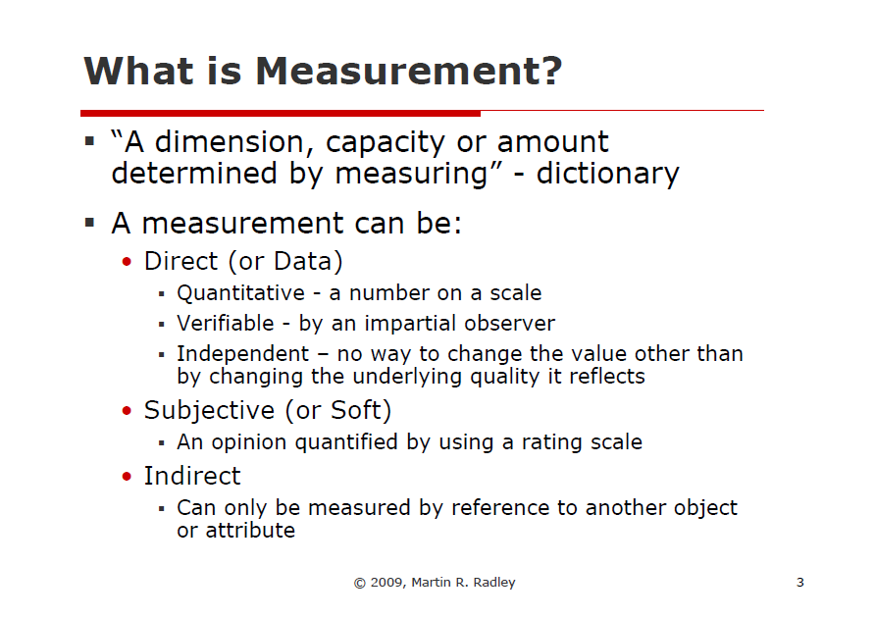
Notes:
Thu’

Slide 4
Direct Measures
What is the Direct Measures?
Direct measurement' refers to measuring exactly the thing that you're looking to measure.
Notes:
Hello and welcome to this presentation of team number 5
My name
I’m very happy
As you Known
In think, we are usually use
In my presentation

Slide 5
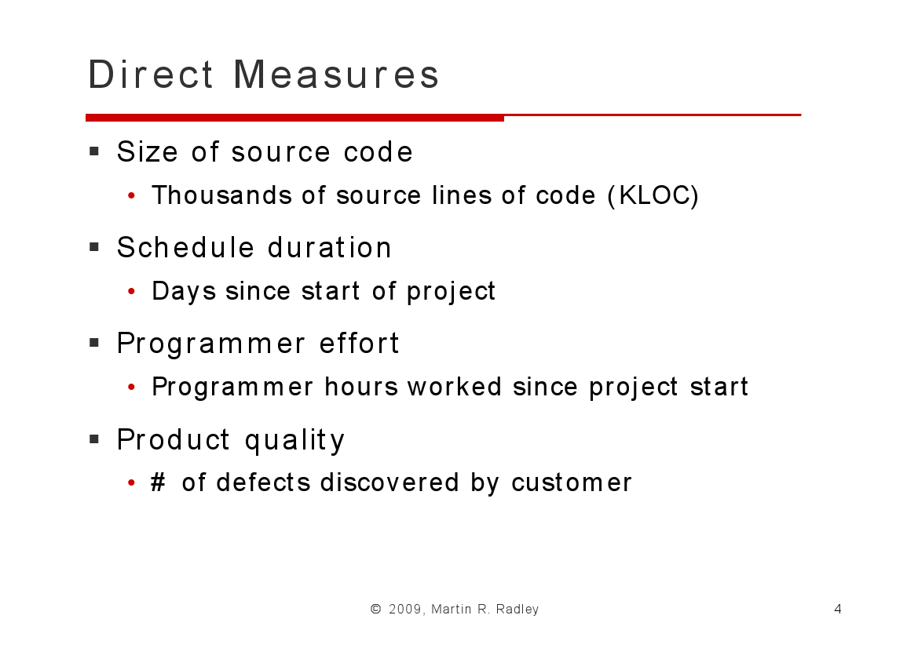
Notes:
Dao

Slide 6
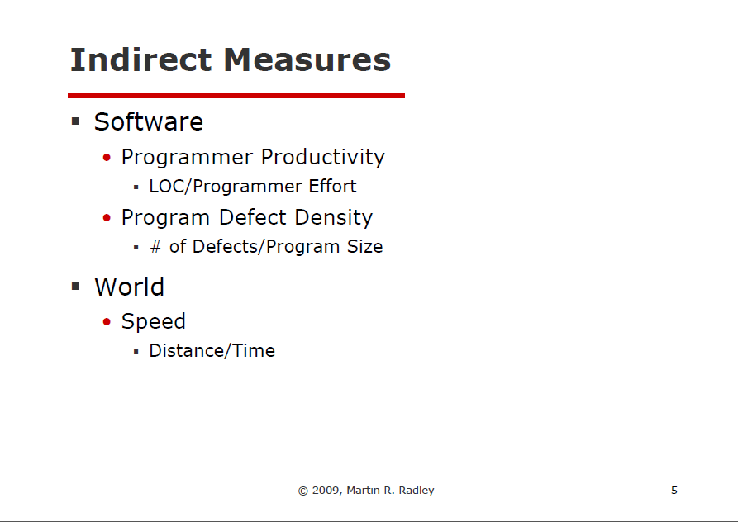
What is indirect measures?
Notes:
Phu

Slide 7
Subjective Measures
Definition: an opinion quantified by using a rating scale
Customer Satisfaction
User Opinion

Slide 8
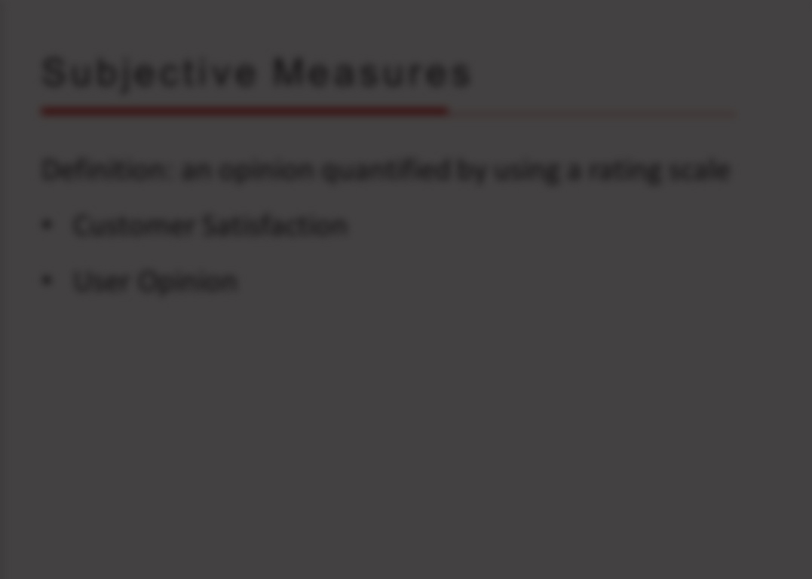

Why we should measure user opinion and customer satisfaction?

Slide 9
Subjective Measures
Definition: an opinion quantified by using a rating scale
Customer Satisfaction
User Opinion
- Measure customer satisfaction or user opinion at key point during the project, not just at the end!

Slide 10
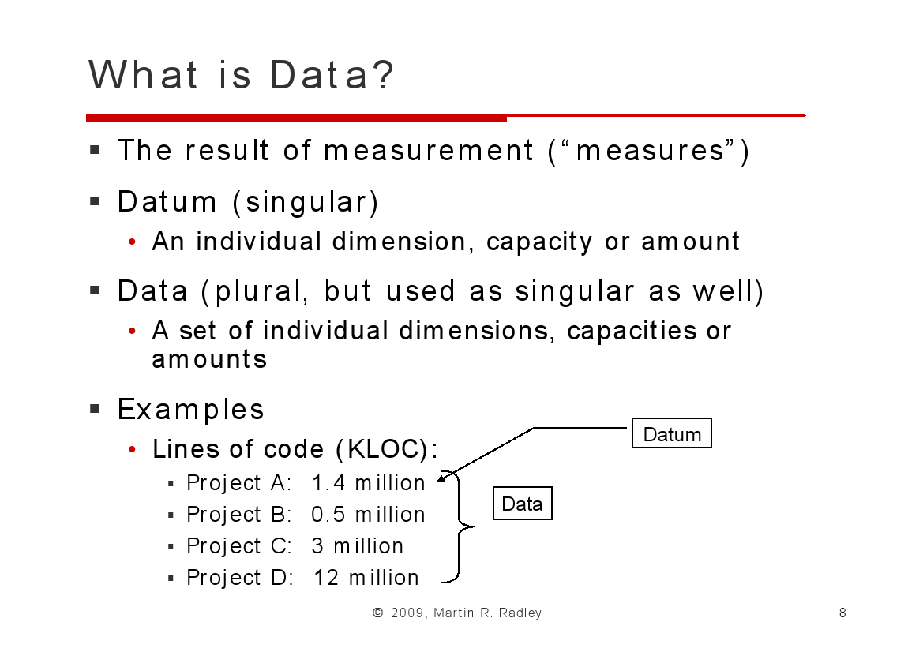



Notes:
Chau

Slide 11
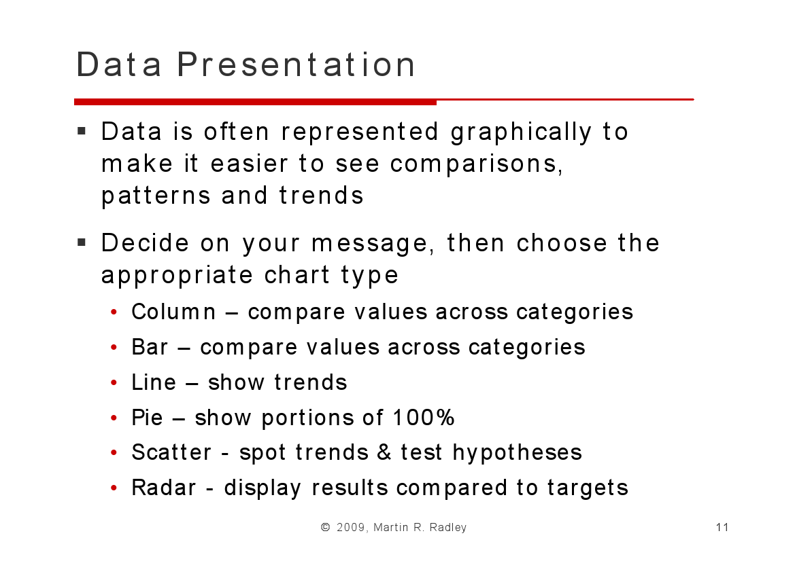
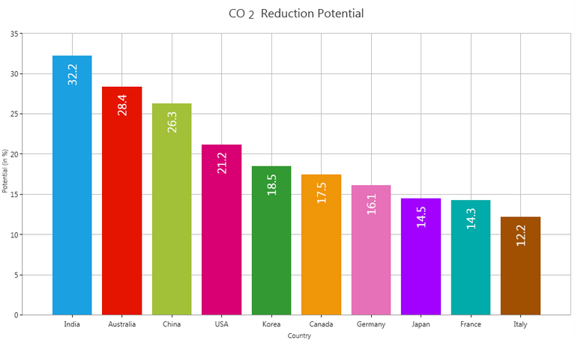
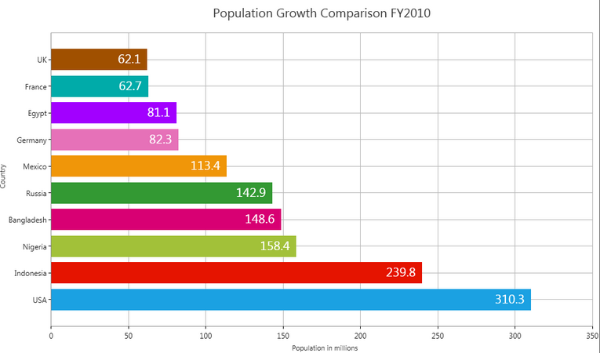
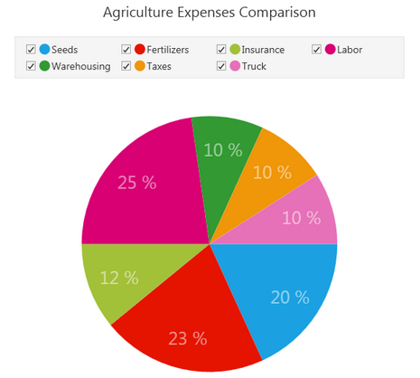

Slide 12

Thanks for your attention

